Slide 1

Data Science and Analytics Datathon 2020

Slide 2

Our Executive Board
President
Joshua Eimer
Executive Vice President
Jeffrey Wong
Chief Financial Officer
Harry Basham
Vice President of Programming
Nicholas Marmann
Vice President of Public Relations
Joyce Gallo
Vice President of Fundraising
Raymond Chen

Slide 3
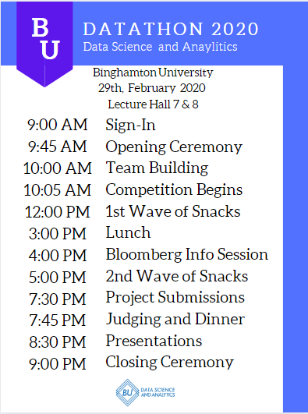
Schedule

Slide 4
Room Schedule
LH 7 - Saturday, 9:00 AM to 9:00 PM
Room with Presentations
Room to eat, hang out, and code
LH8 - Saturday, 9:00 AM to 9:00 PM
Opening Ceremony
Room to quietly collaborate and code
Hallway between LH 7 and 8
Area where Food will be served

Slide 5
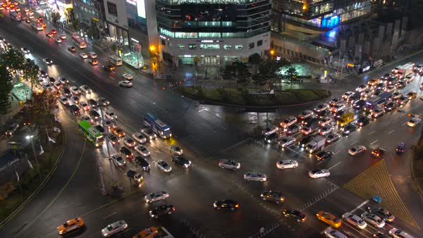
DataSet #1 - US Accidents
Link: https://www.kaggle.com/sobhanmoosavi/us-accidents
Objectives:
Visualization
Most dangerous places
Most dangerous times
Factors affecting severity

Slide 6

DataSet #2 - Graduate Admissions
Link: https://www.kaggle.com/mohansacharya/graduate-admissions
Tasks:
Predict likelihood of admissions
Relevance of GRE and each other piece of criteria

Slide 7

DataSet #3 - Netflix Movies
Link: https://www.kaggle.com/shivamb/netflix-shows
Tasks:
Find relationships between movies and shows to make suggestions to the user
Organize shows based off several criteria (example: best rating for a horror film)

Slide 8
DataSet #4 - Potential Data
1. Corona Virus - mapping the disease and spread (https://www.kaggle.com/sudalairajkumar/novel-corona-virus-2019-dataset)
2. Trending YouTube Videos - what makes something trend/predict what will trend (https://www.kaggle.com/datasnaek/youtube-new)
3. Baseball - what stats make a team/player good (https://www.kaggle.com/arashnic/baseballdatabank)
4. Getting Real About Fake News - predict bias (https://www.kaggle.com/mrisdal/fake-news)
5. Cereal Data (https://www.kaggle.com/crawford/80-cereals?fbclid=IwAR0DlJavS6UGNDF_4aTsv49nze8h1_zP_yHrVaDrnlNEoZh4fXSSwyjyrxI)
6. Spotify Song trends
(https://www.kaggle.com/leonardopena/top50spotify2019/tasks)
7. Wine Reviews
(https://www.kaggle.com/zynicide/wine-reviews)

Slide 9
Github
Link to this presentation and our tutorials
https://github.com/budatascienceandanalytics/Datathon_2020

Slide 10




The Data Scientist Tool kit
The industry standard for spreadsheet software
Free for Binghamton University students
Starting point for any project working with data
A must for any resume
Runs Structured Query Language (SQL) to store and manage large quantities of data
Lightweight free version of the Microsoft SQL server
Used in some respect by most companies that store data
Easy to learn and access compared to other computer programming languages
Pandas library and scikit-learn project have allowed for expansion into projects in machine learning and data manipulations
The original statistical analysis software
Free and more user friendly than other alternatives like Stata and Matlab
Becoming preferred by employers both because of price and flexibility

Slide 11
Prizes
Best for US Accidents
Best for Graduate Admissions
Best for Netflix Movies
Best for Miscellaneous Data
Best Beginner Project
Most Technical Project
Most Creative Project

Slide 12

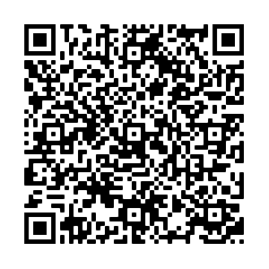
Slack

Slide 13
Team Building
If you don’t have a team, or are looking for more members, after this presentation ends, please go to LH 8 and we will help you find a team.

Slide 14
Code of Conduct
Be respectful
No previous work may be used
Collaborate but don’t plagiarize
Have fun!

Slide 15


Koffman Incubator

Slide 16


Bloomberg

Slide 17
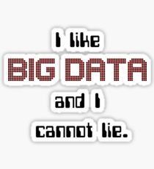
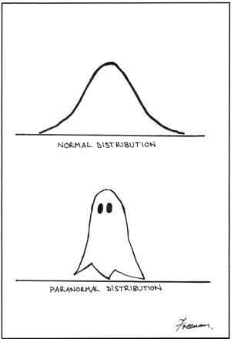
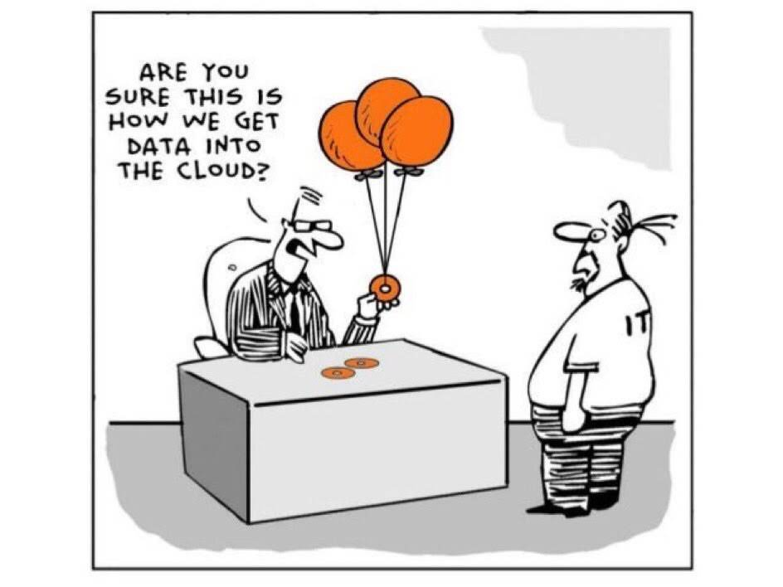
Have Fun!

